Slide 1
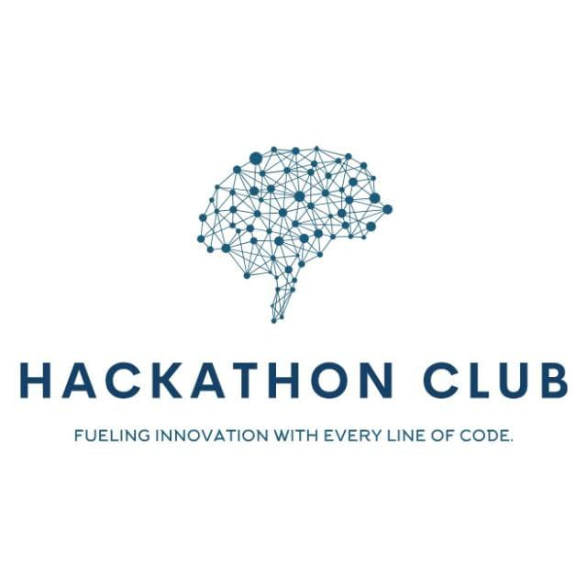

Topic : AI-Enhanced Career Guidance System for Personalized Career Pathways Domain : Student Innovation Team ID : Team189 Team name : Team189 Team members : member1(2303A510I9) member2(2303A510H5) member3(2303A510G7) member4(2303A51360) member5(2303A510I0)

Slide 2

Objective
Develop an AI-powered career guidance system that provides personalized career pathways for students and professionals.
Consider an individual’s aptitude, aspirations, abilities, and work experience to recommend tailored career options.
Provide future progression opportunities based on industry trends and skill gaps.
Ensure an intuitive and engaging user-friendly interface.

Slide 3
Problem Statement
Lack of Personalized Career Guidance: Traditional career counseling methods are often generic and fail to account for an individual's unique skills, interests, and goals.
Misalignment Between Skills and Career Paths: Many individuals struggle to find career paths that match their strengths and aspirations.
Limited Industry Insights: Users lack information about future career progression and emerging job market trends.

Slide 4
Existing system
Describe the current system or method in use:
Career guidance is mostly provided through manual counseling sessions.
Some individuals use online career assessment tests, which offer generalized recommendations.
Institutions organize career fairs or mentorship programs, but they lack personalization.

Slide 5
2. Mention its limitations and inefficiencies. .Lack of Personalization: Generic suggestions that don’t consider individual aspirations, skills, or background. .Outdated Information: Career resources are often static and do not reflect current industry trends. .Limited Industry Insights: Career choices do not incorporate real-time job market demand or future trends. 3. Explain why a new system is needed. .AI-powered career guidance can offer personalized recommendations. .Real-time industry insights help users make informed career decisions. .The system can identify skill gaps and suggest targeted learning opportunities.

Slide 6
4. Use a comparative table (if applicable). Feature:Existing System (Manual Counseling) Proposed System (AI-Powered) Personalization:Generalized career advice AI-driven, tailored recommendations Industry Insights:Limited, outdated information Real-time job market trends Skill Gap Analysis:Not included AI identifies skill gaps Future Progression:No predictive analysis Forecasts career growth & trends Accessibility:Requires in-person meetings Available online 24/7 .

Slide 7
5. Keep the text brief and informative. The existing system lacks personalization, real-time insights, and predictive career guidance. A new AI-powered solution can enhance career decision-making by providing data-driven, tailored recommendations.

Slide 8
Proposed system
AI-Powered Personalization: The system will analyze user data to offer tailored career recommendations.
Dynamic Career Progression: Users will receive future-oriented suggestions based on industry trends and skill gaps.
Comprehensive User Profile: The system will evaluate aptitude, aspirations, abilities, and work experience to generate meaningful insights.
Interactive & Scalable: The solution will be adaptable across different education levels and professional stages.

Slide 9
Workflow
Aptitude & Skill Assessment AI analyzes strengths and competencies.
Gap Analysis – Identifies skill gaps & suggests learning.
Step 02
Step 04
Step 01
Step 03
Step 05
User Profile Creation: Users enter personal data, skills, interests, and experiences.
Final Career Roadmap Provides a data-driven career plan.
Career Pathway Generation Suggests tailored career options.

Slide 10
System Architecture
Tech Stack
Languages Used
Python, c, java,
Database Used
MySQL
Database Security: Encrypted data & role-based access.
Cloud Hosting: AWS/Google Cloud for scalability.
APIs Used: OpenAI (career insights), LinkedIn (job trends).
Key points to cover
Tittle : AI Career Guidance (T189)
Intro:AI for career paths
Problem:Gaps in traditional guidance
Features:Aptitude, skills, growth
Diagram:System overview
Outcome:Better careers, upskilling
End:impact & future scope

Slide 11
Conclusion & Future Scope
Key Takeaways: AI-driven career guidance for personalized planning.
Impact & Benefits: Smarter career choices, better satisfaction, and alignment with job trends.
Future Enhancements: Real-time job listings, AI resume coaching, and career mentoring.
Forward-Thinking Approach: Continuous adaptation to industry needs.
Final Statement: Transforming career planning with data-driven insights.

